Slide 1
Fudz Catering Management System
Jason Muthuo Gikonyo
100949
Supervisor: Faith Siva

Slide 2
Introduction
The business utilizes a manual method of storing all the data that they gain.
This is done by documenting data on paper which at times may be lost or lose relevance due to loss of other data associated with it.
This method of keeping data is quite error-prone.
Most solutions present are too expensive ranging from $69 and above.
The solution is to provide the company with a cost-effective means to store the data they get and be able to manage their inventory by using a web-based system.
This will help in the creation of comprehensive reports that they can use for business decisions in a reliable, time-saving, and cost-effective way
Notes:
How presentation will benefit audience: Adult learners are more interested in a subject if they know how or why it is important to them.
Presenter’s level of expertise in the subject: Briefly state your credentials in this area, or explain why participants should listen to you.

Slide 3
Functional Requirements
The system must allow a registered user to login to the system.
The system must also take inventory details and store them.
The system must be able to output all the data it has stored.
The system must also allow an administrator to register new users and view user detail.
The system must be able to provide the user with a means to input data to the system.
The system should be able to provide a simple analysis based on the data stored.
Notes:
Lesson descriptions should be brief.

Slide 4
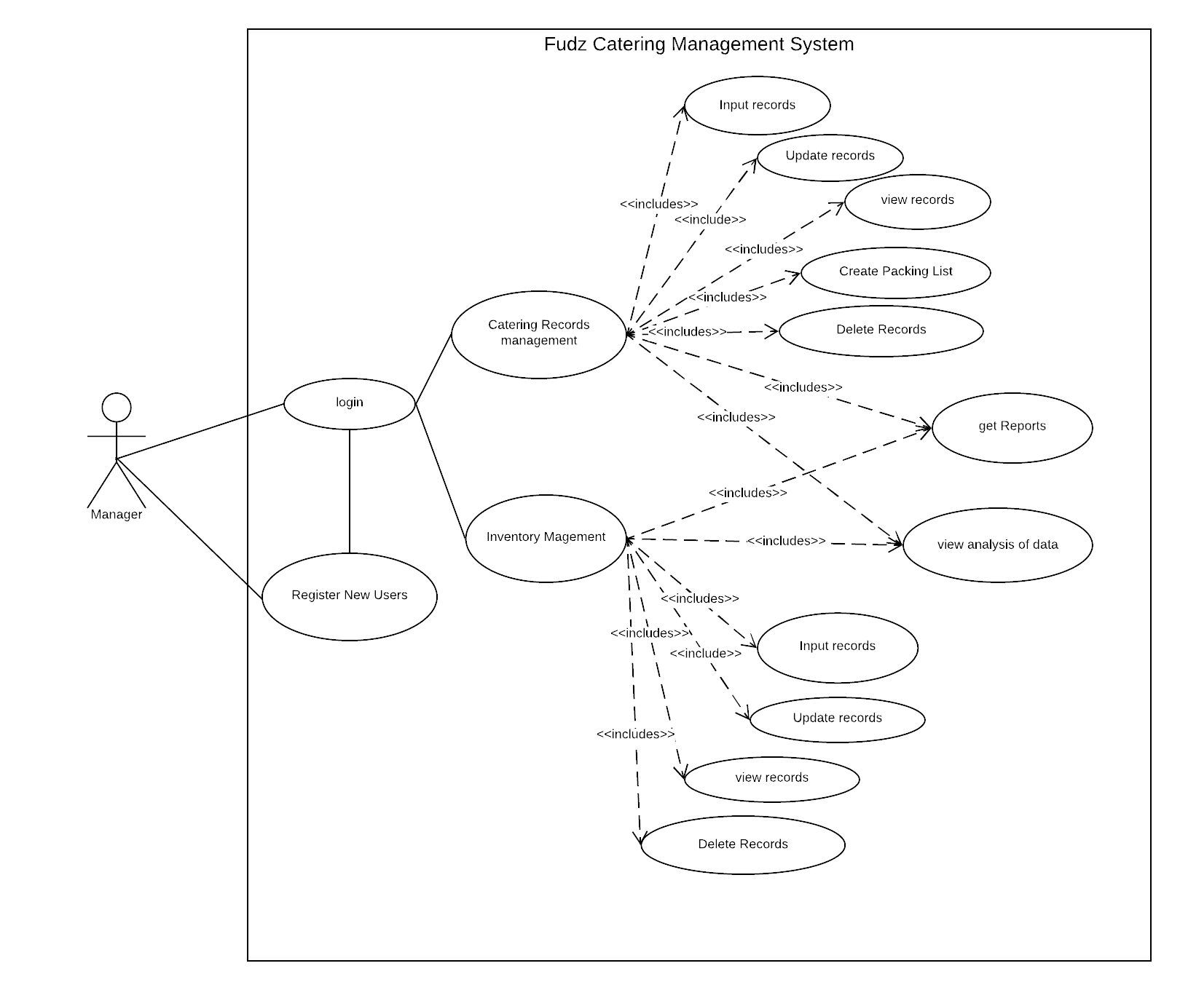
Use Case
Notes:
Example objectives
At the end of this lesson, you will be able to:
Save files to the team Web server.
Move files to different locations on the team Web server.
Share files on the team Web server.

Slide 5
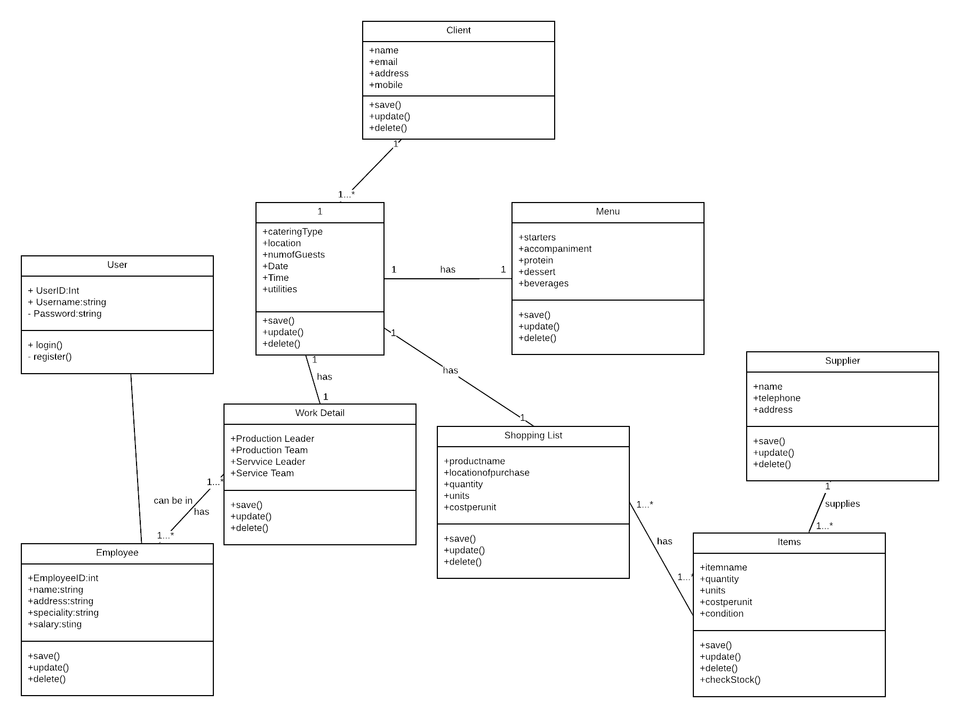
Class Diagram

Slide 6
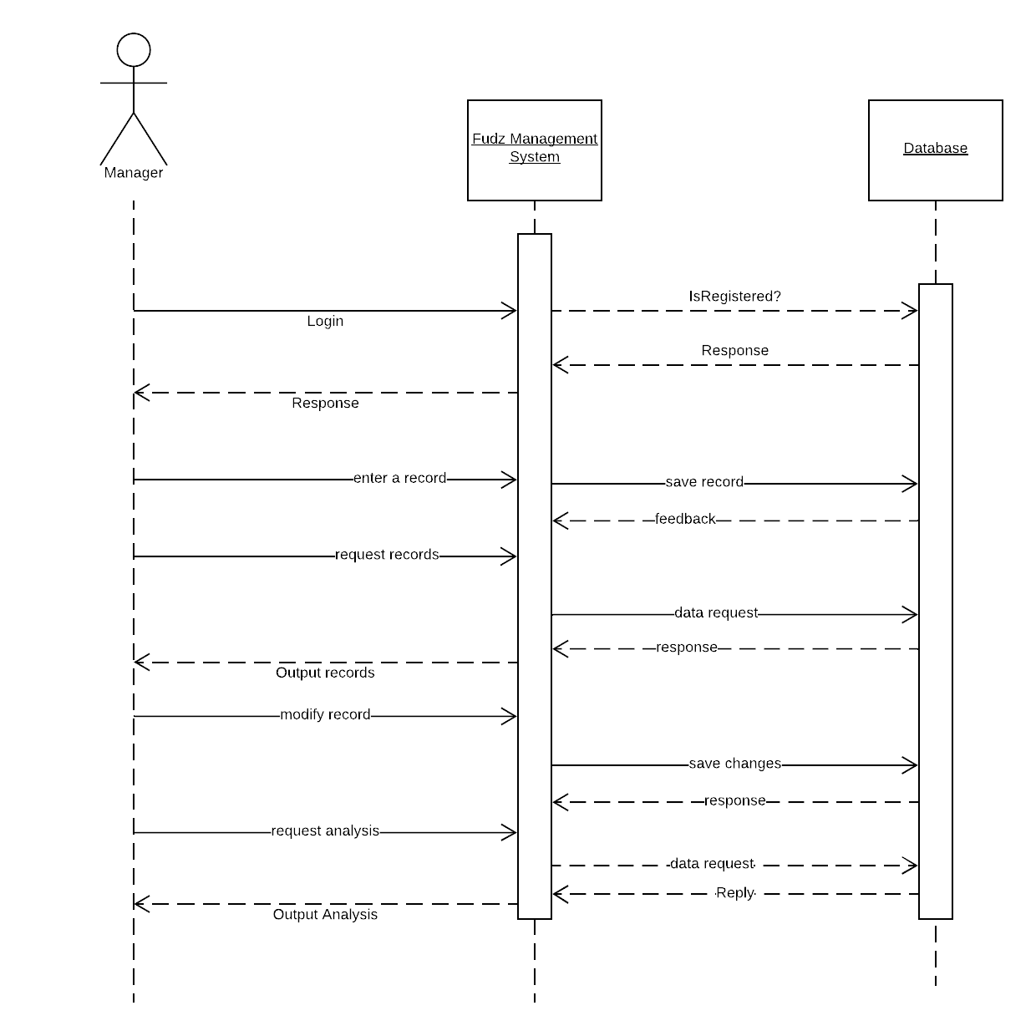
Sequence Diagram

Slide 7
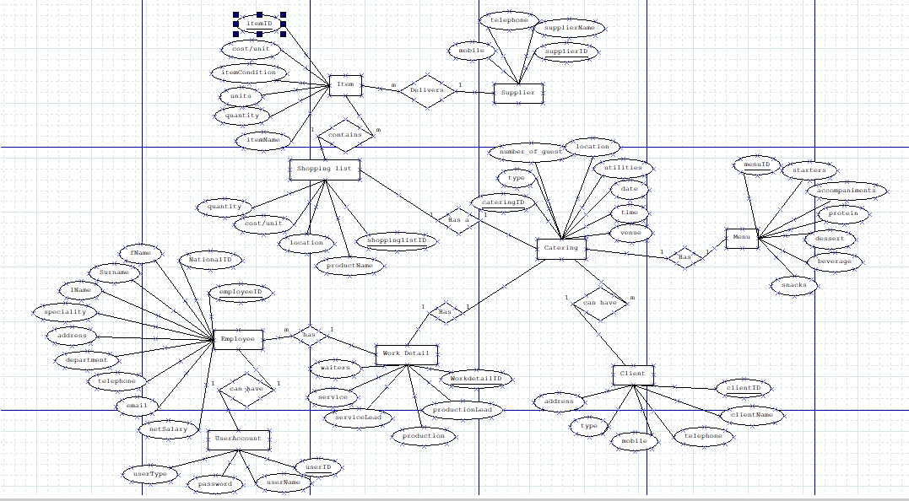
ERD

Slide 8
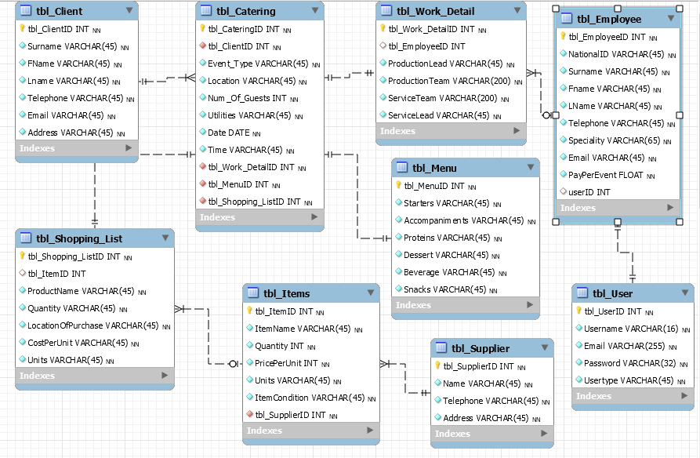
Database Schema

